Slide 1
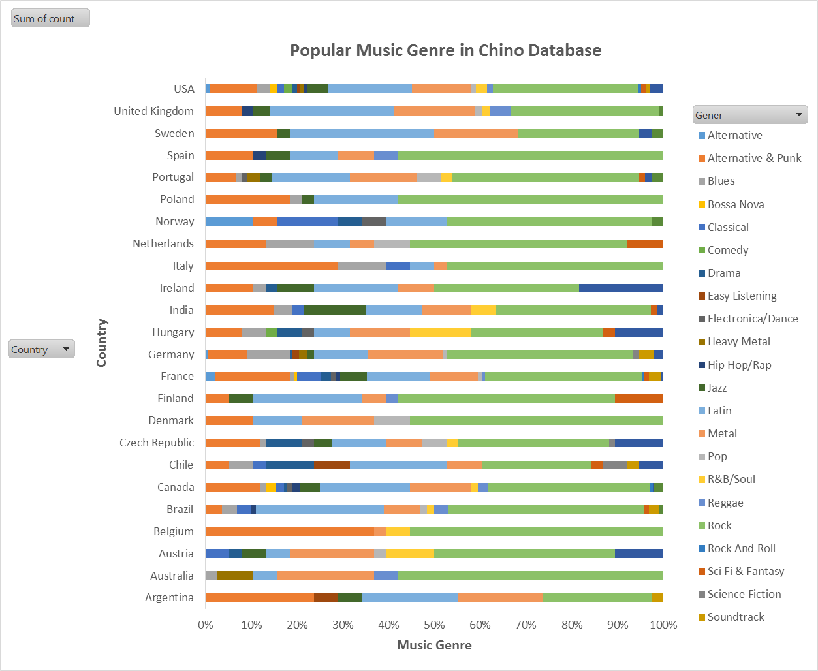
Popular Music Genre
As the stocked bar illustrate, we can see that the most purchase music genera among all the countries is the ‘Rock’ (the light green bar). It might be a good indicator start promoting rock music in thier application patform or website.

Slide 2
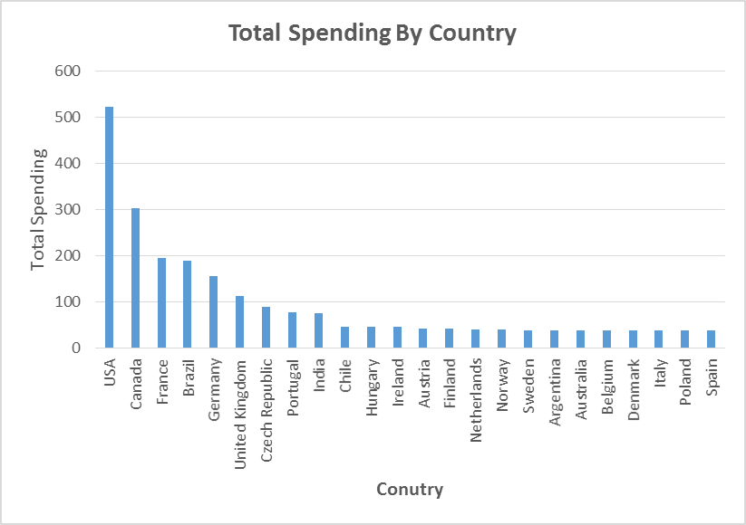
Total Spending by Country by Months
Best customers who believe in our service came form USA. The prefered month which has higher sale in USA is September. I have tried to find out why September has high total sale than other months and I have read a an interesting Wikipedia article about ‘Labor Day’ in USA and they were stating the following:
“Labor Day is called the "unofficial end of summer” because it marks the end of the cultural summer season. Many take their two-week vacations during the two weeks ending Labor Day weekend. Many fall activities, such as school and sports begin about this time”.
With the previous citation, we may suggest to music producer to have their new Album released during this month.

Slide 3
Most Spending City
The chart show that “Prague” is the most spending city and the most profitable city. We may suggest to throw a promotional Music Festival which can increase our profits.

Slide 4
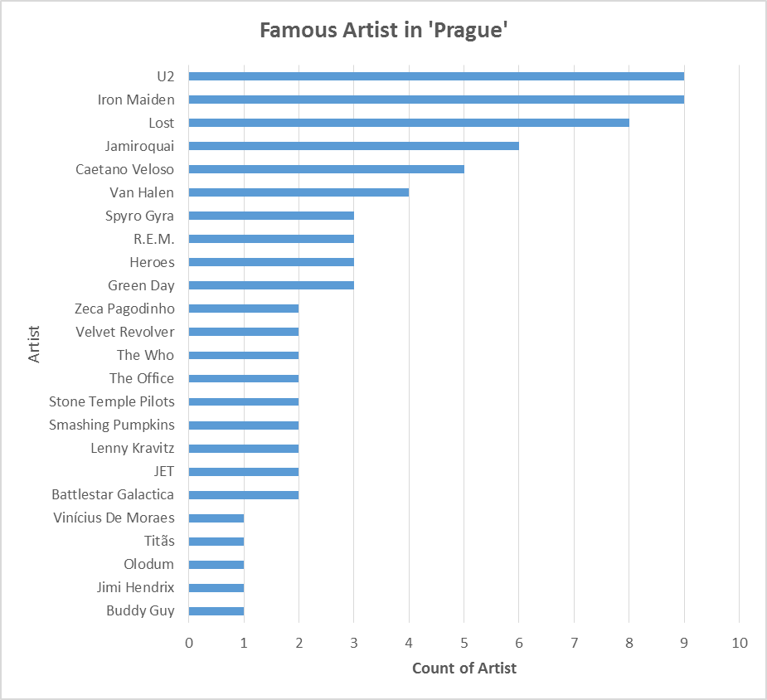
Famous Artist in ‘Prague’
So, if we decieded to hold concert in ‘Prague’ for our fans there. We need to bring ‘U2’ and ‘Iron Maiden’ bands to perform live there. The charts clearly showing that we these two bands are famous enough to make the concert successful.

